Slide 1
STAT 6371: FINAL REVIEW

Slide 2
Topics
Know The Definition of Type 1 and Type 2 Error and Power.
Be able to find and interpret confidence intervals and how they are related to hypothesis tests and p-values.
Know the 1 and 2 sample T-Tests. Be able to perform a complete analysis: State the Problem, Address the Assumptions, Run the Test, clearly state the conclusion / results.
Know how to perform a complete analysis with non-parametric tests. Rank-Sum, Sign-Test, Signed Rank, Etc.
Know Multiple Comparison Methods: Bonferroni, Tukey-Kramer, Dunnett’s
Be very familiar with running an ANOVA and interpreting the results. (KRUSKAL-WALLIS AS WELL.)
Know Simple and Multiple Linear Regression
Know how to interpret coefficients: both continuous and categorical and interactions.
Know how to interpret coefficients after a log – log, linear log or log linear model.
Know how to find and interpret confidence and prediction intervals.
Know about Assumptions, Residuals, Checking for Influential Points. (Leverage, studentized residuals, Cook’s D, etc.)
Know about confounding and how to account for particular potential confounding variables.
Know about experimental design: Randomized Experiment v. Observational Study.
Know how and why to perform an Extra Sum of Squares Test
Know how and why to perform a lack of fit test.
Know what forward selection, backward elimination and stepwise selection are and be able to select a model through using any of those methods.
Know how to find confidence intervals / standard errors for linear combinations of parameter estimates.

Slide 3
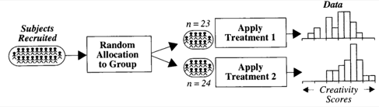
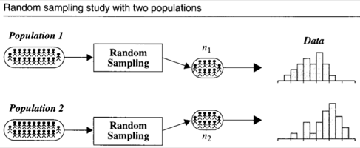
Types of Studies
Creativity Study
Salary Study
Randomized Experiment
Observational Study

Slide 4
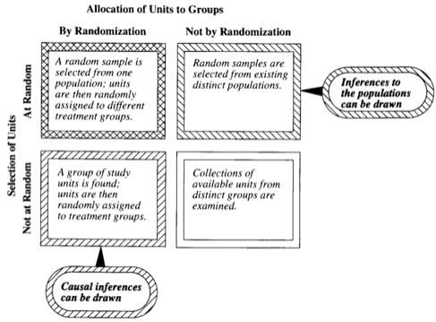
Cause and Effect vs. Inference to Larger Population
Inference can only be drawn to the subjects in the sample or the population that the group was randomly sampled from (possibly a subpopulation of the population of interest.
Only an association can be drawn.

Slide 5
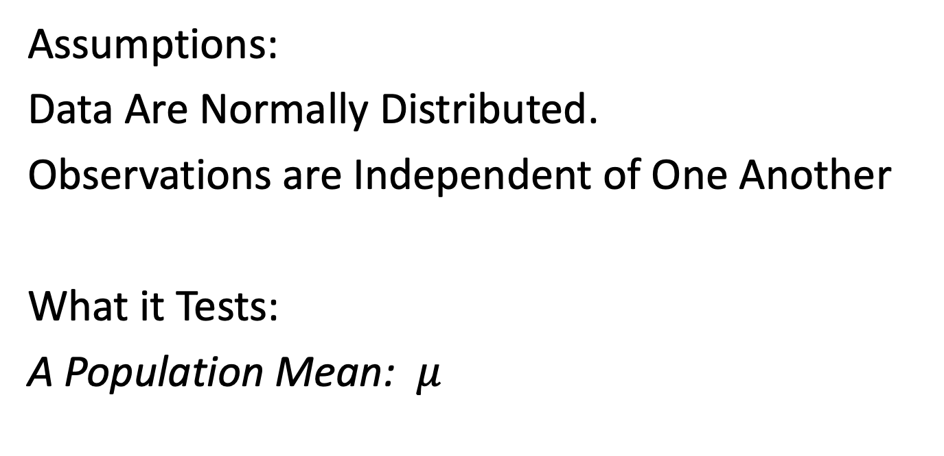
1 Sample T- Test!
Assumptions:
Data Are Normally Distributed.
Observations are Independent of One Another
What it Tests:
A Population Mean: $μ$

Slide 6
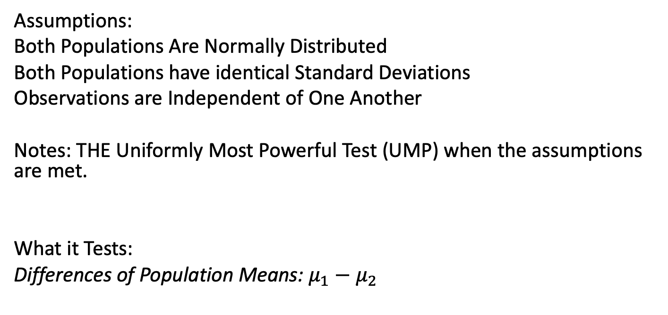
2 Sample T- Test!
Assumptions:
Both Populations Are Normally Distributed
Both Populations have identical Standard Deviations
Observations are Independent of One Another
Notes: THE Uniformly Most Powerful Test (UMP) when the assumptions are met.
What it Tests:
Differences of Population Means: $μ_{1}−μ_{2}$

Slide 7
Robustness of T-Test
T-Tests (T-Tools … Tests and Confidence Intervals) are Robust to departures from normality.
3 Cases Emerge:
If sample sizes are sufficiently large and are the same, the t-test is robust to departures from normality and differences in variance (sd).
If sample sizes are sufficiently large and the standard deviations are the same, the t-tests are robust to departures from normality and different sample size.
If the sample sizes are different (even if they are large) and the variances / standard deviations are different, alternatives to the pure t-test are suggested.

Slide 8
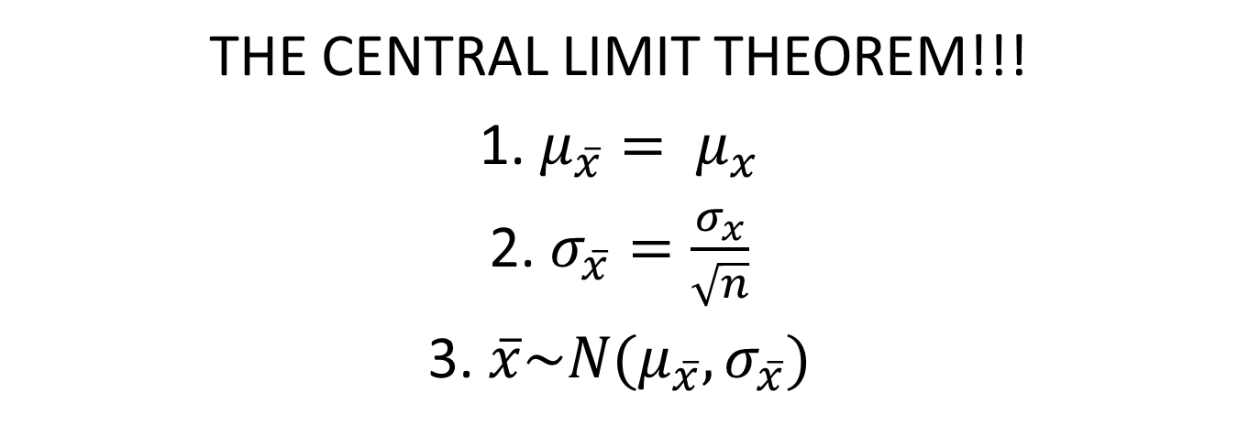
Holy Grail for the Robustness of the T-Test
THE CENTRAL LIMIT THEOREM!!!
1. $μ_{\overline{x}}= μ_{x}$
2. $σ_{\overline{x}}=\frac{σ_{x}}{\sqrt{n}}$
3. $\overline{x}\sim N(μ_{\overline{x}},σ_{\overline{x}})$

Slide 9

Notes about the F-Test for Equal Variance
Ho: population variances are equal
Ha: population variances are not equal
Assumption:
The two Populations are Normally Distributed
USE AS SECONDARY / SUPPORT EVIDENCE AFTER A VISUAL CHECK OF THE HISTOGRAM, BOX PLOT and Q-Q PLOT. A Great alternative is the Brown-Forsythe Test … it has fewer assumptions.

Slide 10
Tests for Paired Data

Slide 11
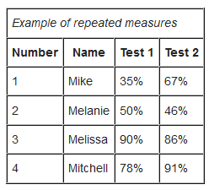
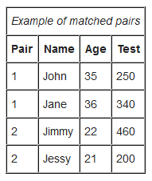
Paired (aka Matched Pairs or Dependent) T-Test
Assumptions
Data are either:
from one sample that has been tested twice (example pre- and post-test / repeated measures)
Or from a group of subjects that are thought to be similar and can thus be matched or paired (example from same family, or twins)
Differences are normally distributed.
Notes: Not Resistant to Outliers.
What it tests: Mean Difference is Different than 0.

Slide 12
Sign Test
Assumptions:
Data are able to be paired.
Differences are independent.
Data is ordinal.
Notes:
1. Not a very powerful test but easy and quick.
2. Resistant to Outliers
What is tests: Tests if the Median Difference is different than 0.

Slide 13
Signed Rank Test
Assumptions:
Data are able to be paired.
Differences are independent.
Data is ordinal.
Notes:
1. More powerful than the Sign Test since it uses more information (the ranks).
2. Resistant to Outliers
What is tests: Tests if the Median Difference is different than 0.

Slide 14
Let’s Practice With Some Scenarios!

Slide 15
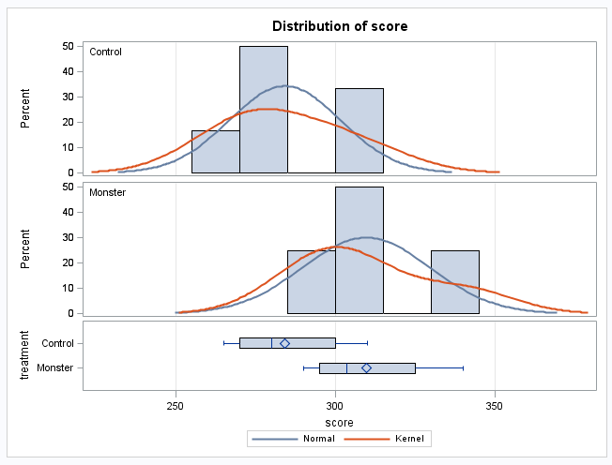
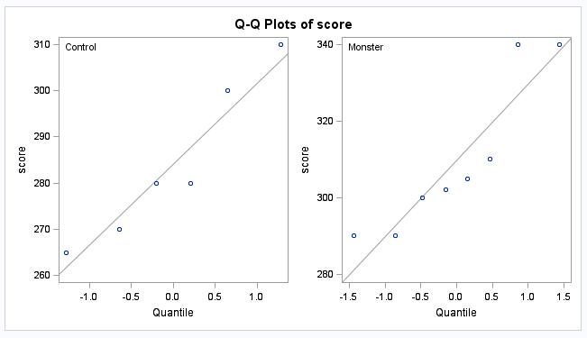
Dataset 1: Monster Drink Study
Monster 300
Monster 310
Monster 290
Monster 305
Monster 302
Monster 290
Monster 340
Monster 340
Control 280
Control 310
Control 270
Control 280
Control 265
Control 300

Slide 16
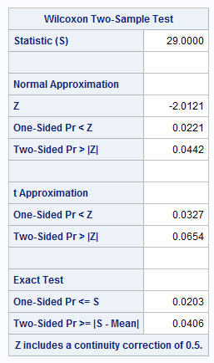
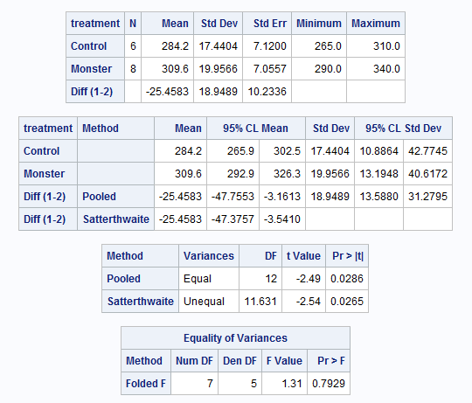
Which Test?

Slide 17
Sample Analysis
Assumption:
With the relatively low sample size we cannot be sure of the normality of the two populations. The histograms, box plots and q-q plots do not show any obvious departures from normality, although we do not have much confidence in this assumption since the sample size is so low. In addition, if there is a departure from normality, this small sample size may not be enough to invoke the central limit theorem.
Although the sample sizes are still very small, the plots provide evidence that the two distributions have the same shape. For this reason, the Rank-Sum Test was chosen as it is robust to departures from normality with small sample sizes and can be used to test medians when the shapes are the same.

Slide 18
Test Selected: Rank Sum Test
Ho: Median_{Monster} = Median_{Control}
Ha: Median_{Monster} > Median_{Control}
Step 2 – Step 5
Conclusion: There is sufficient evidence at the alpha = .05 level of significance (p-value = .0203 from the exact rank sum test) that the median Monster Drinks increased the median score on this test when compared to the control group. An estimate of this improvement is 23.5 points.

Slide 19
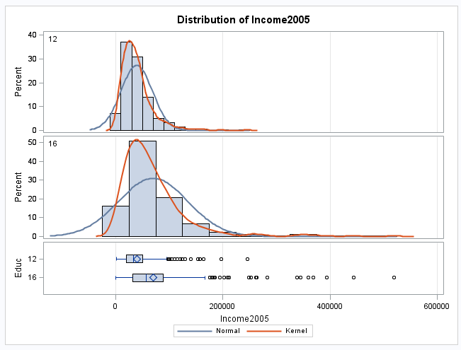
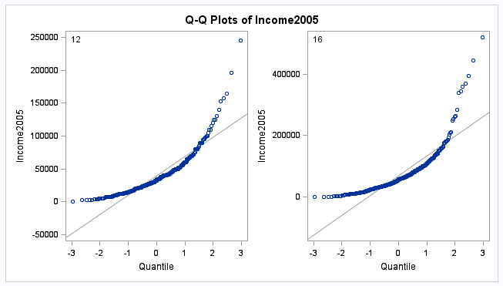

Dataset 2: Education Data from HW2
?
?

Slide 20
Sample Analysis
Since the sample size is so large, the histograms are indeed a good representation of the individual populations. This provides strong evidence that the populations are right skewed and thus not normal. While this is a violation of the t-test assumptions, the large sample size also ensures that the sampling distribution of the sample mean will be normally distributed (CLT) which mitigates the violation of normality.
However, the sample sizes are considerably different and a visual check of the box plots and histograms indicate evidence that the standard deviations are different. For this reason, it is not appropriate to pool the variances; instead, since the t-test is robust to departures from normality when the sample sizes are sufficiently large, we will use Welch’s T –Test to account for the differing standard deviations. We will test to see if the mean income of those with 16 years of education is greater than the mean income of those with only 12 years of education.

Slide 21
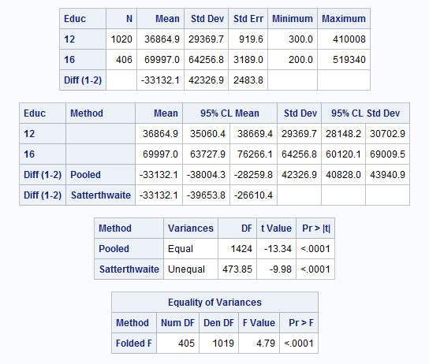
Test Selected: Welch’s T -Test
Ho: µ₁₆ – µ₁₂ = 0
Ha: µ₁₆ - µ₁₂ > 0
Step 2 – Step 5
Conclusion:
There is very strong evidence at the alpha = .05 level of significance (p-value < .0001/2=0.00005 from the Welch’s T-Test) that the mean income of those with 16 years of education is greater than the mean income of those with only 12 years of education for those in this study.

Slide 22
Topics
Know The Definition of Type 1 and Type 2 Error and Power.
Be able to find and interpret confidence interval and how they are related to hypothesis tests and p-values.
Know the 1 and 2 sample T-Tests. Be able to perform a complete analysis: State the Problem, Address the Assumptions, Run the Test, clearly state the conclusion / results.
Know how to perform a complete analysis of with non-parametric tests. Rank-Sum, Sign-Test, Signed Rank, Etc.
Remember Multiple Comparison Methods.
Remember ANOVA
Extra Sum of Squares F –Test (Partial F-Test)
Know Simple and Multiple Linear Regression
Know how to interpret coefficients.
Know how to create models.
Know about Assumptions, Residuals, Checking for Influential Points.
Know about confounding and how to account for particular potential confounding variables.
Know about experimental design: Randomized Experiment v. Observational Study.

Slide 23
Chapters 6 and 7!!!
1 WAY ANOVA
BROWN FORSYTHE TEST
KRUSKAL-WALLIS
CONTRASTS
MULTIPLE COMPARISONS

Slide 24
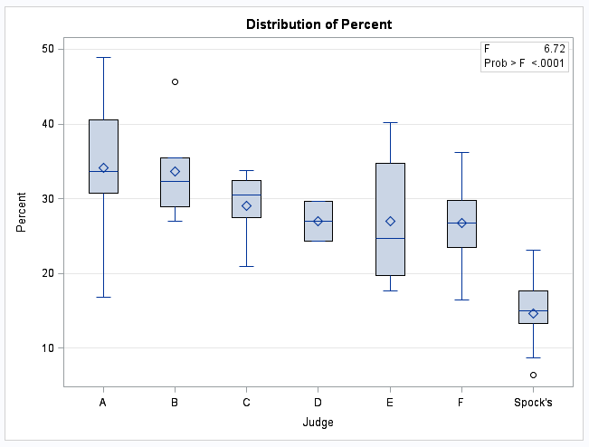
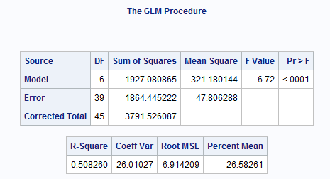

1 Way ANOVA
Ho: All means are equal (Spock and Others)
Ha: At least 2 are different (Spock and Others)

Slide 25
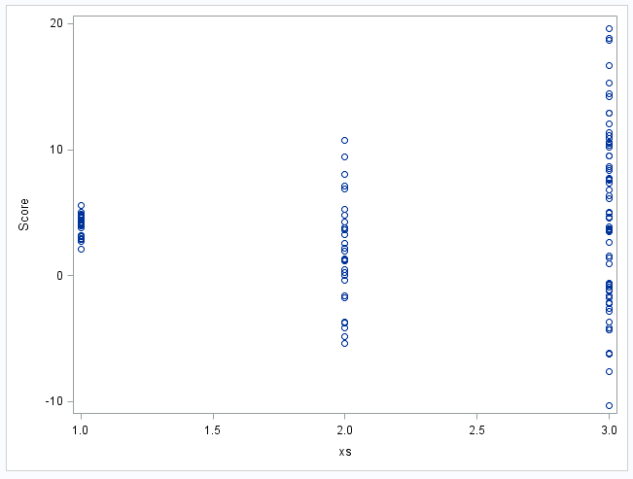
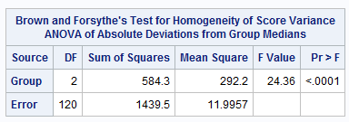
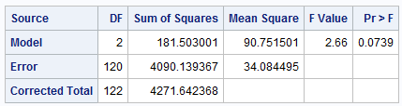
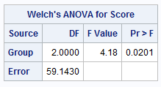
Assumptions and Analysis:
There is strong evidence in support of these data coming from distributions with different standard deviations. We will proceed under this assumption and run the Welch’s ANOVA.
There is sufficient evidence at the alpha = .05 level of significance (p-value .0201 from Welch’s ANOVA) to suggest that at least two of the means are different.

Slide 26
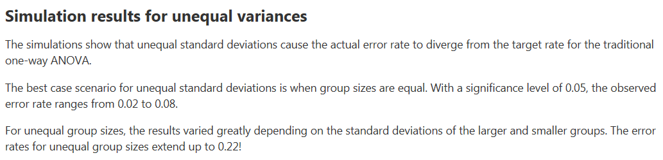
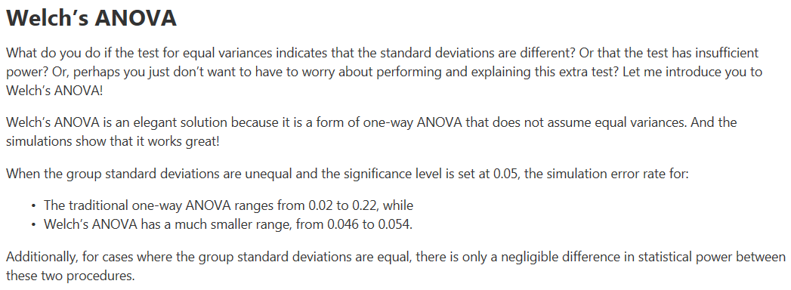
Performance of Welch’s Test

Slide 27
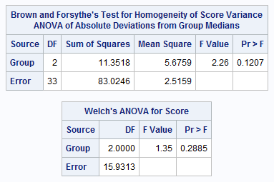
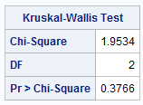
Kruskal-Wallis Test
There is not sufficient evidence at the alpha = .05 level of significance (p-value .3766 from Kruskal-Wallis Test) to suggest that at least two of the medians are different.
Notice that each test failed to reject their respective Ho. The point isn’t so much that one test will reject when the other will fail to reject. We must remember that as statisticians we don’t personally favor one outcome over the other. We just want the appropriate test: the one with the most power, and the point is that the Kruskal-Wallis Test is the appropriate test.

Slide 28
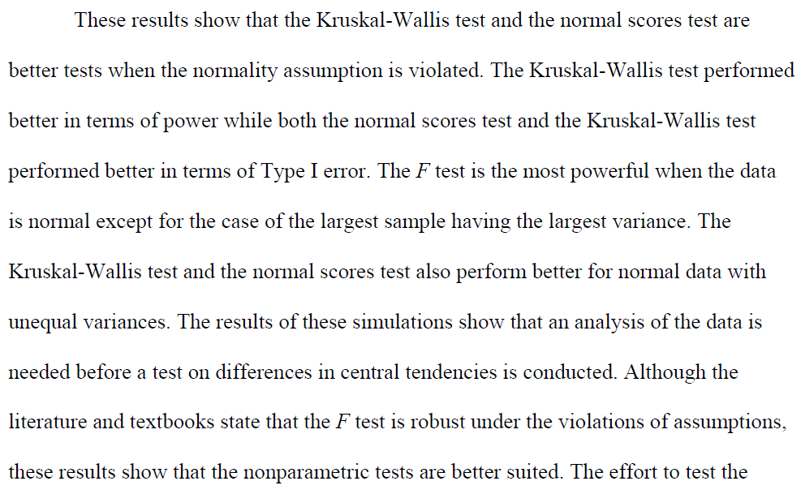
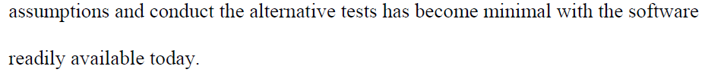
Kruskal-Wallis: Simulation Study
http://etd.fcla.edu/WF/WFE0000158/Patrick_Joshua_Daniel_200905_MS.pdf

Slide 29
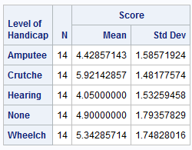
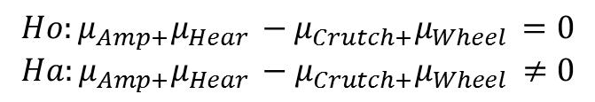
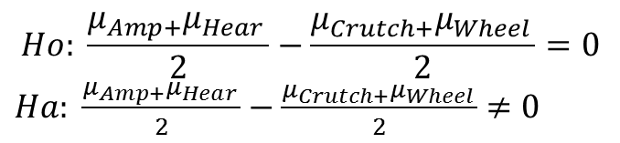

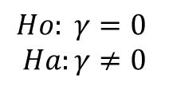
FIRST QOI: Is the mean of Amputee/Hearing different than the mean of Wheelchair/Crutches
$$Ho: \frac{μ_{Amp+}μ_{Hear }}{2}=\frac{μ_{Crutch+}μ_{Wheel }}{2}$$
$$Ha: \frac{μ_{Amp+}μ_{Hear }}{2}≠\frac{μ_{Crutch+}μ_{Wheel }}{2}$$
$$Ho: \frac{μ_{Amp+}μ_{Hear }}{2}−\frac{μ_{Crutch+}μ_{Wheel }}{2}=0$$
$Ha: \frac{μ_{Amp+}μ_{Hear }}{2}−\frac{μ_{Crutch+}μ_{Wheel }}{2}$ $≠0$
$$Ho:{μ_{Amp+}μ_{Hear }−μ}_{Crutch+}μ_{Wheel }=0$$
$$Ha:{μ_{Amp+}μ_{Hear }−μ}_{Crutch+}μ_{Wheel }≠0$$
Contrast →
$γ=1μ_{amp }−1μ_{Crutch }$ $+1μ_{Hear }$ $+0μ_{None }−1μ_{Wheel}$
$$Ho: γ=0$$
$$Ha:γ≠0$$

Slide 30
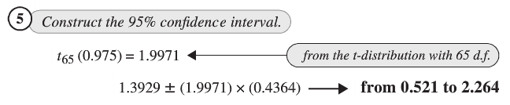


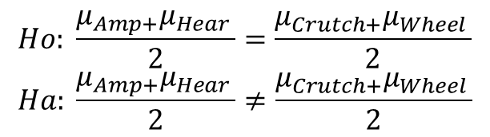
Unit 7
$$Ho: \frac{μ_{Amp+}μ_{Hear }}{2}=\frac{μ_{Crutch+}μ_{Wheel }}{2}$$
$$Ha: \frac{μ_{Amp+}μ_{Hear }}{2}≠\frac{μ_{Crutch+}μ_{Wheel }}{2}$$
$γ=1μ_{Amp}−1μ_{Crutch}$ $+1μ_{Hear}$ $+0μ_{None}−1μ_{Wheel}$

Slide 31

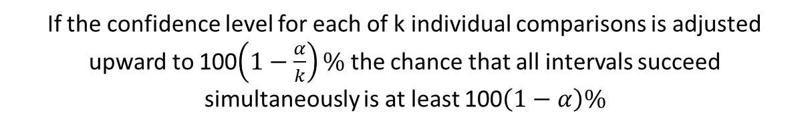
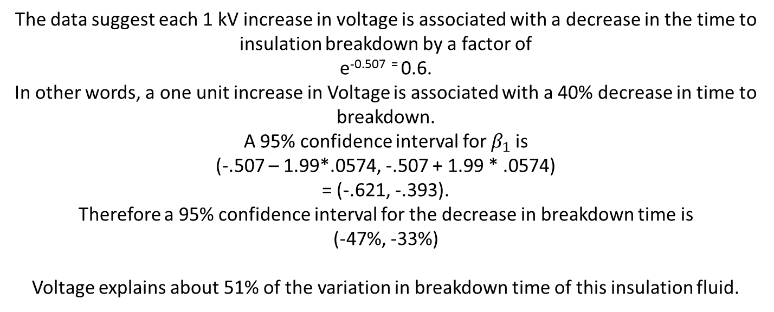
Multiple Comparison: Bonferroni
If the confidence level for each of k individual comparisons is adjusted upward to 100$\left(1−\frac{α}{k}\right)\%$ the chance that all intervals succeed simultaneously is at least 100$\left(1−α\right)\%$
$$multiplier= t_multiplier=t_{\left(1−\frac{α}{2k}\right),df}$$
Very conservative meaning that the intervals are much wider than the nominal level. However, the Bonferroni interval can be used in a wide variety of problems.

Slide 32
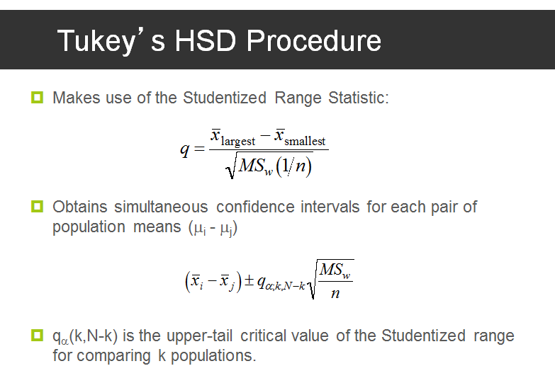

Multiple Comparison: Tukey-Kramer
Studentized Range Statistic Table
Multiplier =
Assumes normal distributions and equal spreads.
More consistent than Bonferroni with respect to Type 1 Error but not robust to its assumptions…. Bonferroni is a good alternative when the assumptions are violated.

Slide 33

Multiple Comparison: Dunnett’s Many Groups to one Control
$$t_{1}=\frac{{\hat{μ}}_{C}−{\hat{μ}}_{1}}{{SE}_{{\hat{μ}}_{C}−{\hat{μ}}_{1}}}$$
$$t_{2}=\frac{{\hat{μ}}_{C}−{\hat{μ}}_{2}}{{SE}_{{\hat{μ}}_{C}−{\hat{μ}}_{2}}}$$
…
$$t_{n}=\frac{{\hat{μ}}_{C}−{\hat{μ}}_{n}}{{SE}_{{\hat{μ}}_{C}−{\hat{μ}}_{n}}}$$
Replaces t-distribution with a multivariate t-distribution to account for the correlation.

Slide 34
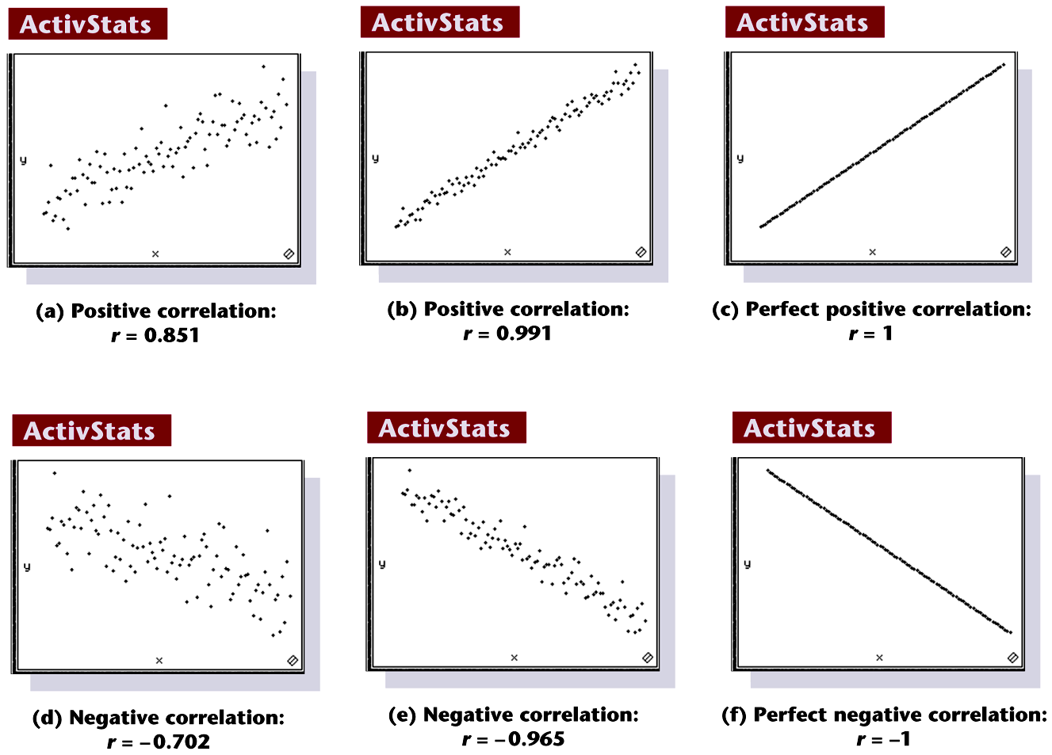
Scatterplots of Paired Data
Notes:
Page 619 of text

Slide 35
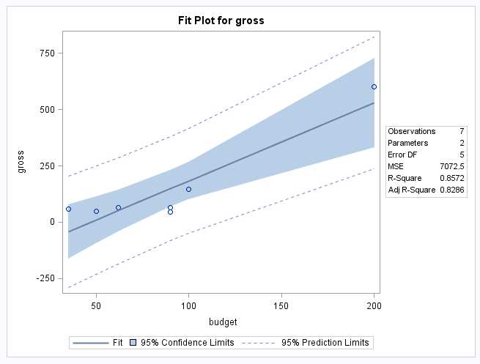

Confidence Intervals
-
Confidence Intervals
Budgets | Est Value | SE Est Value | Lower Lim | Upper Lim
35 | -42.61978 | 46.9740057 | -163.370303 | 78.13074882
65 | 61.542928 | 35.3959431 | -29.4452408 | 152.531096
95 | 165.70563 | 31.9718347 | 83.5194147 | 247.8918499
125 | 269.86834 | 38.9170078 | 169.828984 | 369.9076903
155 | 374.03104 | 52.282405 | 239.722664 | 508.3394195
185 | 478.19375 | 68.3244731 | 302.560097 | 653.8273956
200 | 530.2751 | 76.8670268 | 332.682116 | 727.8680814
We are 95% confident that the mean gross when the budget is $95 million is between $83 and $247 million.
We are 95% confident that the mean gross when the budget is $185 million is between $303 and $654 million.

Slide 36

Prediction Intervals
Prediction Intervals
Budgets | Est Value | SE Est Value | Lower Lim | Upper Lim
35 | -42.61978 | 96.32801 | -290.23881 | 204.9992556
65 | 61.542928 | 91.2436358 | -173.006305 | 296.0921605
95 | 165.70563 | 89.970698 | -65.5714098 | 396.9826744
125 | 269.86834 | 92.6664005 | 31.661771 | 508.0749029
155 | 374.03104 | 99.0071054 | 119.525175 | 628.5369083
185 | 478.19375 | 108.354796 | 199.658875 | 756.7286177
200 | 530.2751 | 113.93449 | 237.397167 | 823.15303
This data suggests that 95% of movies with a budget of $95 million will gross between -$65 million and $396 million.
The predicted gross of a single movie with a budget of $95 million is $165 million. A 95% confidence interval for this estimate is between -$65 to $396 million.

Slide 37
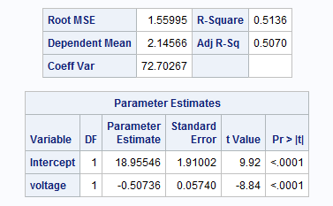
Interpretation: Log – Linear
The data suggest each 1 kV increase in voltage is associated with a decrease in the time to insulation breakdown by a factor of
e^{-0.507 =} 0.6.
In other words, a one unit increase in Voltage is associated with a 40% decrease in time to breakdown.
A 95% confidence interval for $β_{1}$is
(-.507 – 1.99*.0574, -.507 + 1.99 * .0574)
= (-.621, -.393).
Therefore a 95% confidence interval for the decrease in breakdown time is
(-47%, -33%)
Voltage explains about 51% of the variation in breakdown time of this insulation fluid.

Slide 38



Log Transforms: Linear - Log
$$Y=β_{0}+β_{1}Log(X)$$
$$μ\text{\{}\text{Y}\text{|}\text{log}\text{(}\text{X}\text{)\}=}β_{0}+β_{1}Log(X)$$
$μ\text{\{}\text{Y}\text{|}\text{log}\text{(2}\text{X}\text{)}\}−μ\text{\{}\text{Y}\text{|}\text{log}\text{(}\text{X}\text{)}\}=β_{1}$Log(2X) - $β_{1}$Log(X)
$μ\text{\{}\text{Y}\text{|}\text{log}\text{(2}\text{X}\text{)}\}−μ\text{\{}\text{Y}\text{|}\text{log}\text{(}\text{X}\text{)}\}=β_{1}[$Log(2X/X)]
$μ\text{\{}\text{Y}\text{|}\text{log}\text{(2}\text{X}\text{)}\}−μ\text{\{}\text{Y}\text{|}\text{log}\text{(}\text{X}\text{)}\}=β_{1}$Log(2)
A doubling of X results in a $β_{1}$Log(2) unit increase in the mean of Y.
A Confidence Interval Can be easily obtained from Confidence Limits: $β_{1}±t_{\frac{α}{2},df}∗SE(β_{1}$)

Slide 39
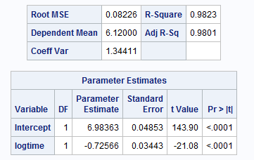
Interpretation: Linear – Log
$$\hat{μ} \text{\{}\text{pH}\text{|}\text{log}\text{(}\text{Time}\text{)\}=}6.984−.7257Log(Time)$$
The data suggest that the mean pH decreases by
(-.72556)log(2) = -0.503
for each doubling of time.
A 95% confidence interval is from
((-.72556 - 2.31*.03443)log(2), (-.72556 + 2.31*.03443)log(2))
= (-.558, -.448).
Time explains about 98.23% of the variation in pH for these steer carcuses.

Slide 40





Further Interpretation: Log-Log
$$μ\text{\{}\text{log}\text{(}\text{Y}\text{)|}\text{log}\text{(}\text{X}\text{)\}=}β_{0}+β_{1}(Log\left(x\right))$$
$$Median\left(Y | X\right)=e^{β_{0}}X^{β_{1}}$$
$$Median\left(Y | 2X\right)=e^{β_{0}}{\left(2X\right)}^{β_{1}}$$
$Median\left(Y | 2X\right)/Median\left(Y | X\right)=e^{β_{0}}{(2X)}^{β_{1}}$/$e^{β_{0}}X^{β_{1}}$
$Median\left(Y | 2X\right)/Median\left(Y | X\right)={(2X)}^{β_{1}}$/$X^{β_{1}}$
$$Median\left(Y | 2X\right)/Median\left(Y | X\right)=2^{β_{1}}$$
Therefore a doubling of X equates to multiplicative change of
$2^{β_{1}}$ for the median of Y given X.

Slide 41
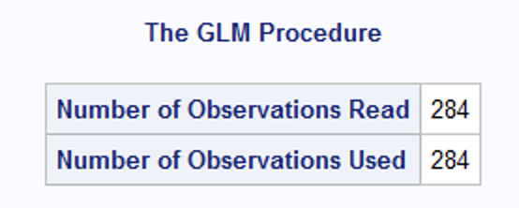
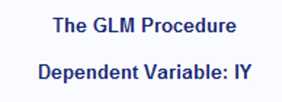
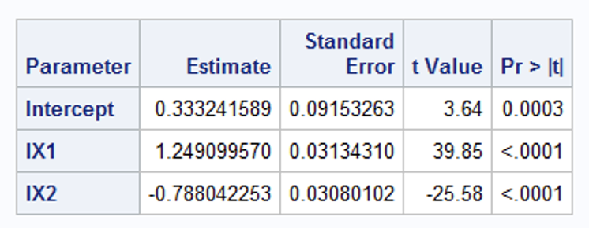

Breakout 1
$$\hat{\log\left(y\right)}= β_{0}+β_{1}log\left(X_{1}\right)+β_{2}log\left(X_{2}\right)$$
Interpret the lX1 slope (coefficient) and include a 99% confidence interval.
Holding all other variables constant, It is estimated that each doubling of X1 is associated with a 2^{1.249} = 2.38 multiplicative increase in the median of Y. That is, a doubling of X1 is associated with a 138% increase in the median of Y. A 99% confidence interval for this factor is (2^{1.249-2.594*.031}, 2^{1.249+2.594*.031}) = (2.25, 2.51).

Slide 42
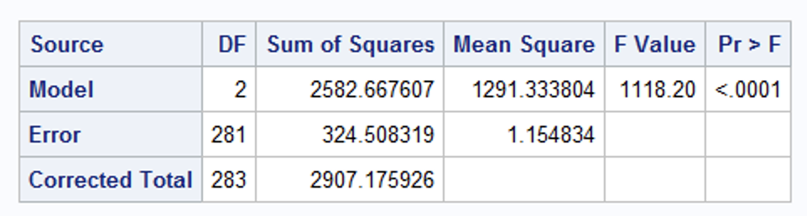
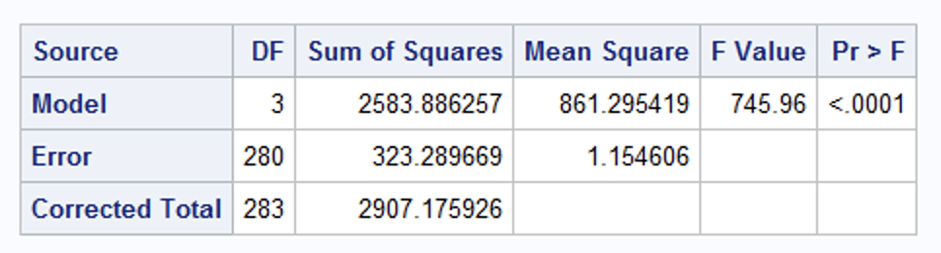

Breakout 2: Extra Sum of Squares Test
We would like to test if there is evidence from an extra sum of squares test to suggest the inclusion of a squared term. Compare the two models and with an extra sum of squares and defend your choice of models. There were 284 observations.
$$\hat{\log\left(y\right)}= β_{0}+β_{1}log\left(X_{1}\right)+β_{2}log\left(X_{2}\right)$$
$$\hat{\log\left(y\right)}= β_{0}+β_{1}log\left(X_{1}\right)+β_{2}log\left(X_{2}\right)+β_{3}{log\left(X_{2}\right)}^{2}$$
Source | DF | Sum of Squares | Mean Square | F Value | Pr > F

Slide 43
Breakout 2: Extra Sum of Squares Test
We would like to test if there is evidence from an extra sum of squares test to suggest the inclusion of a squared term. Compare the two models and with an extra sum of squares and defend your choice of models. There were 284 observations.
$$\hat{\log\left(y\right)}= β_{0}+β_{1}log\left(X_{1}\right)+β_{2}log\left(X_{2}\right)$$
$$\hat{\log\left(y\right)}= β_{0}+β_{1}log\left(X_{1}\right)+β_{2}log\left(X_{2}\right)+β_{3}{log\left(X_{2}\right)}^{2}$$
Source | DF | Sum of Squares | Mean Square | F Value | Pr > F
Model | 1 | 1.22 | 1.22 | 1.06 | .304
Error | 280 | 323.29 | 1.15
Corrected Total | 281 | 324.51
There is not enough evidence to suggest that adding a squared term will be useful in the model (pvalue = .304 from an extra sum of squares test.)

Slide 44
$\hat{\log\left(y\right)}= β_{0}+β_{1}X_{1}+β_{2}Freshman+$ $+β_{2}Freshman+$

Slide 45
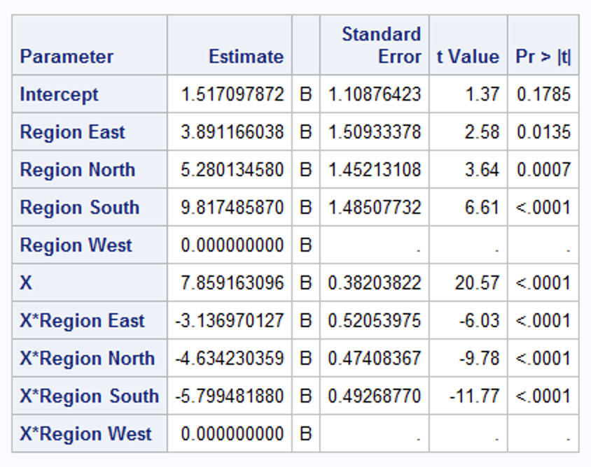






Breakout 3 Categorical Variables and Interactions
$$Region North$$
X*$Region North$
$$5.28±1.96∗1.452$$
$$-4.63±1.96∗.474$$
$$(2.43, 8.13)$$
$$(−5.56, −3.7)$$
Given the parameter estimate table above, assume all assumption are met. Interpret the Region North and X*Region North parameter estimates. Of course, quantify the uncertainty in the inference… that is … provide 95% confidence intervals.
It is estimated that when X = 0, the mean of the distribution of Y is 5.28 (95%: (2.43, 8.13)) units more in the North than in the West. In addition, we are 95% confident that for each unit increase in X, the mean of the distribution of Y will increase between 3.7 and 5.56 units slower than it will in the West. Our best estimate is 4.63 units slower.

